Slide 1
Group 1 - Midterm
Formula 1 Data Set Visuals
CSC302
March 25, 2023
Roderick Payne
Matthew Jackson
Kati Johnson

Slide 2

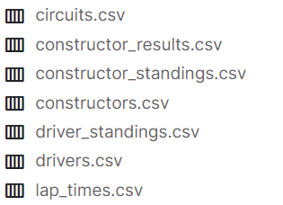
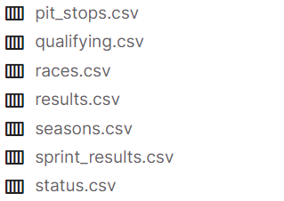
Data Utilized
Formula 1 World Championship (1950 - 2023)
https://www.kaggle.com/datasets/rohanrao/formula-1-world-championship-1950-2020

Slide 3
Our Questions
Q1 - What constructor has the most series wins?
Expectation: Mercedes will be on top of list
Q2 - Which constructor runs the fastest pit stops?
Expectation: Red Bull (it gives you wings)
Q3 - What country has the most F1 race tracks
Expectation: European based country
Q4 - Have Lewis Hamilton average lap times decreased over time?
Expectation: Lap times got slower over time

Slide 4
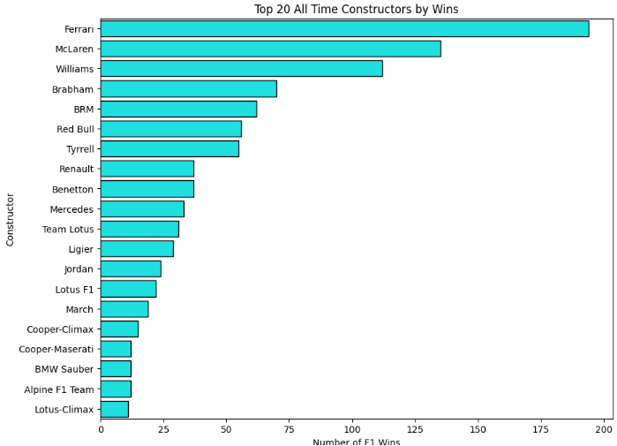
Q1 Visualization
Only 40 different winners in history
Ferrari most dominant with 194 wins
McLaren and Williams are only others above 100
Mercedes with just 33 wins
Code
sb.barplot(data=alltime, y = 'name', x = 'wins',
color = 'green', alpha = 1, linewidth = 1, edgecolor = 'blue')
plt.title('Top 20 All Time Constructors by Wins')
plt.ylabel('Constructor')
plt.xlabel('Number of F1 Wins')
ewidth = 1, edgecolor = 'blue')
plt.title('Top 20 All Time Constructors by Wins')
plt.ylabel('Constructor')
plt.xlabel('Number of F1 Wins')
Conclusion: Expectation incorrect likely as a result of recency bias and insufficient knowledge of subject

Slide 5
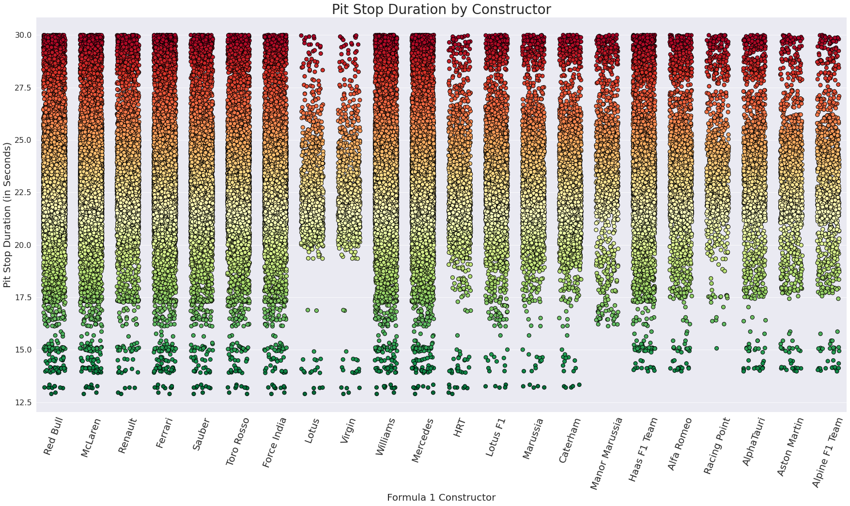
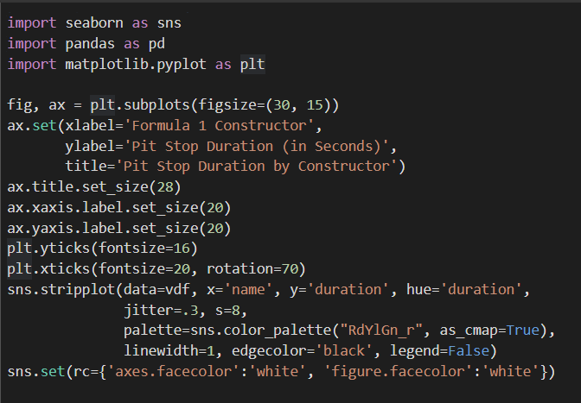
Q2 Visualization
22 constructors appear
Red Bull, McLaren, Ferrari, Williams, and Mercedes appear to have the fastest pit stops with the most frequency
Scope of data was trimmed - duration was capped at 30 seconds
Conclusion: Red bull runs the fastest pit stops of any Formula 1 constructor

Slide 6
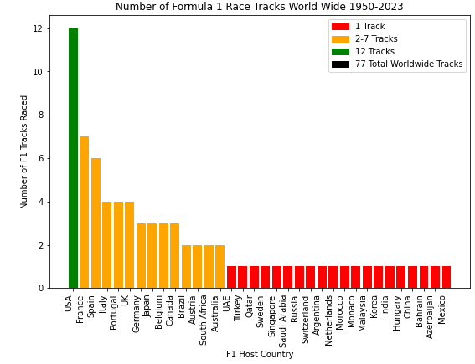
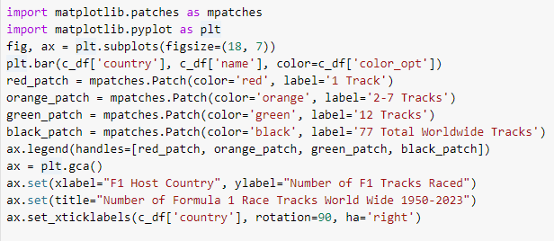
Q3 Visualization
77 total F1 Race
Tracks 1950-2023
20 Countries with only one F1 track
USA has the most F1 tracks run in history at 12
Conclusion: Non-European country USA has the most F1 tracks for a single country at 12. However Grouped European Countries exceed this value considerably.

Slide 7
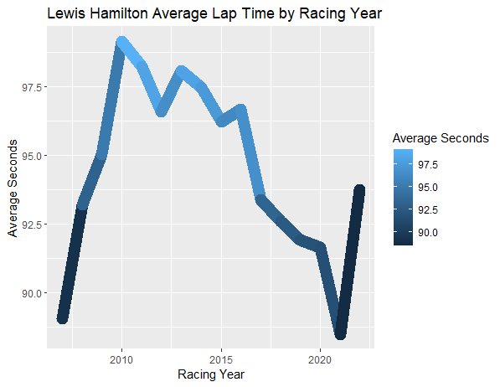
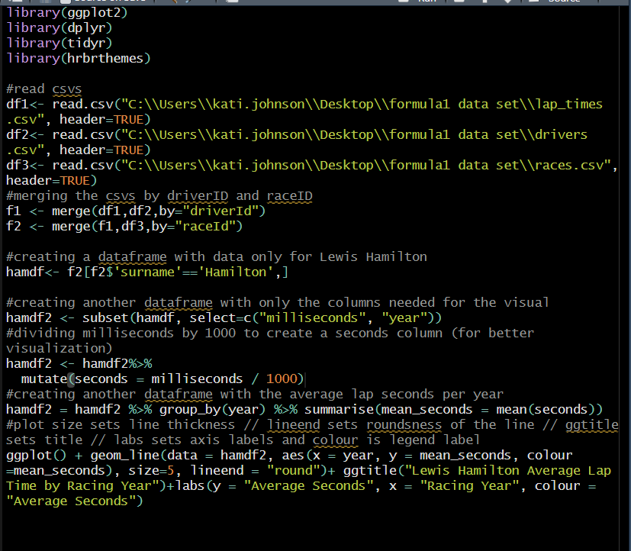
Q4 Visualization
Lewis Hamilton has won the most races of any F1 driver so we wanted to see how quick his lap speeds were on average by year
Conclusion: Lewis Hamilton’s lap times on average have gotten faster over time.

Slide 8
Conclusions
Formula 1 has a lot of interesting data to work with
Data can be focused in various ways, including by drivers, constructors, race tracks
The dataset being split into many CSV files made it more challenging to work with
Github Repository
https://github.com/katijumich/Midterm-Group-1

